Slide 1
Linear layer
2021-03-26
4th grade
Jaeho Jeon

Slide 2
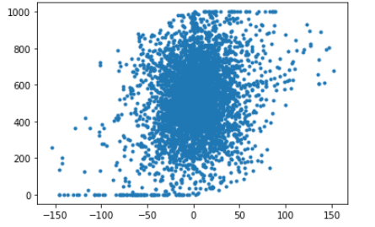
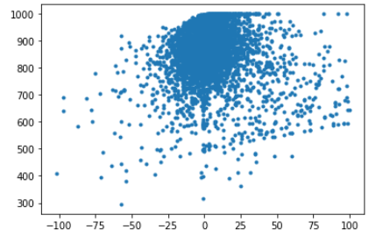
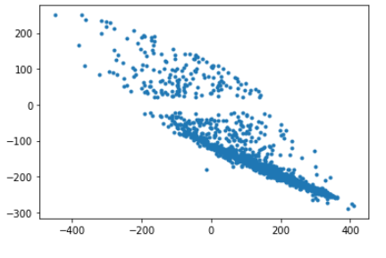
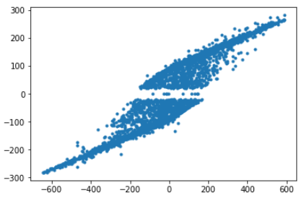
프로젝트 제목
tiltLoop.m_command
panLoop.m_command
panOffset(x axis)
tiltOffset(y axis)
transLoop.m_command
rotateLoop.m_command
transOffset
rotateOffset
transOffset = tiltOffset + tiltLoop.m_command + CENTER_POS
rotateOffset = panOffset + panLoop.m_command - CENTER_POS;

Slide 3
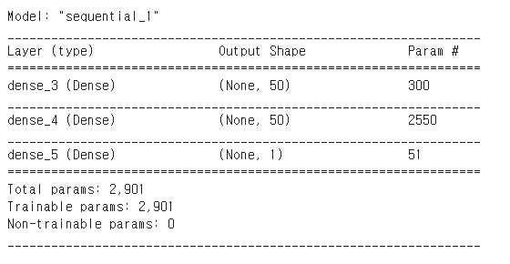
프로젝트 제목
Input size = 5, standardization
Output = 1
1
X
5
input
5
X
50
Dense1
50
X
50
Dense
2
50
X
1
Dense 3
tanh
tanh
1x1
predic
kernel_initializer=‘glolat normal'
bias_initializer='zeros'
activation='tanh'
model.compile(optimizer=sgd_optimizer, loss='mse')
Epoch = 50, lr = 1*e-6

Slide 4
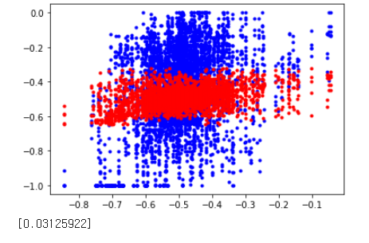
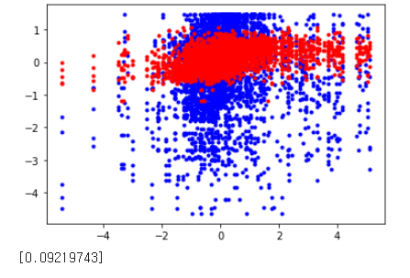
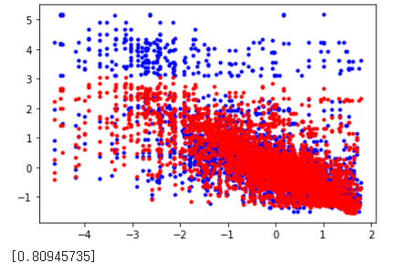
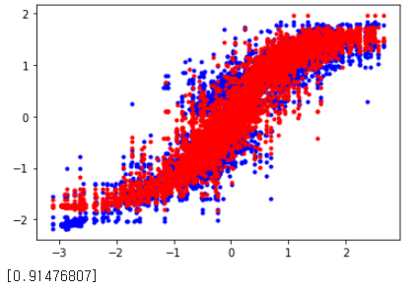
프로젝트 제목
Training 4000 test 1116
Pan_loop
Tilt_loop
train
test
Trans_loop
Rotate_loop

